Slide 1
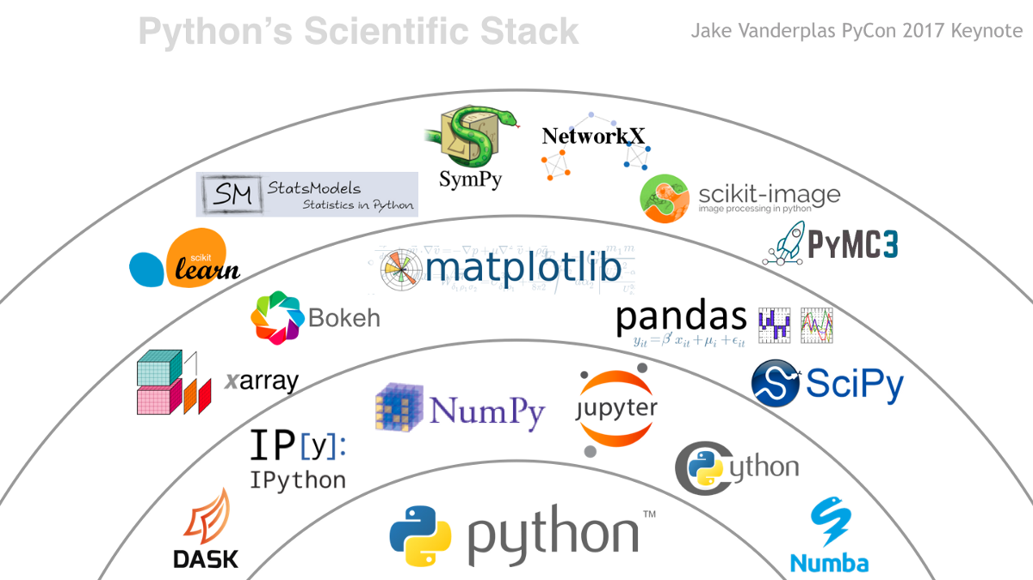
PARALLELISING PANDAS USING DASK

Slide 2
3 Main points of Dask
Introduction and Working of Dask in Python
Implementation of data preprocessing and model building using Dask comparing the results.
Limitations of Dask

Slide 3
Architecture of dask
Dask collection
Dask.dataframe
Dask.arrays
dask.bag
Dask Schedulers
Python ecosystem
Dask graph specification

Slide 4
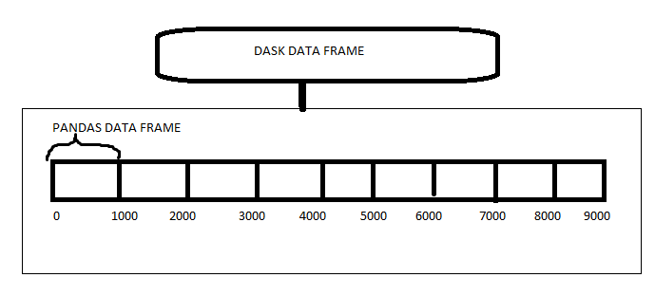
Working of the dask
DASK is a python library that can handle moderately large datasets on a single CPU by using multiple cores of machines or on a cluster of machines (distributed computing).
Mainly used for Parallel computing

Slide 5
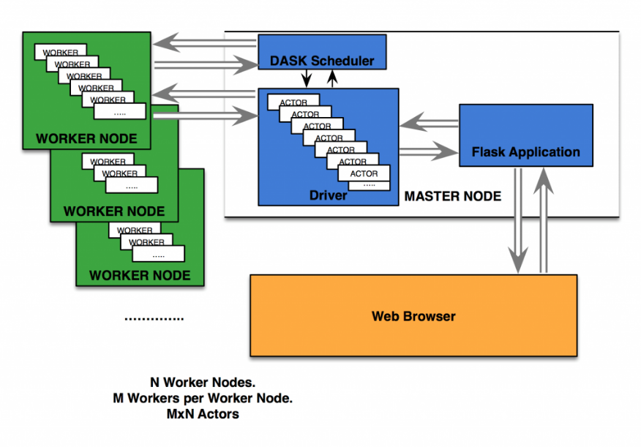

Slide 6
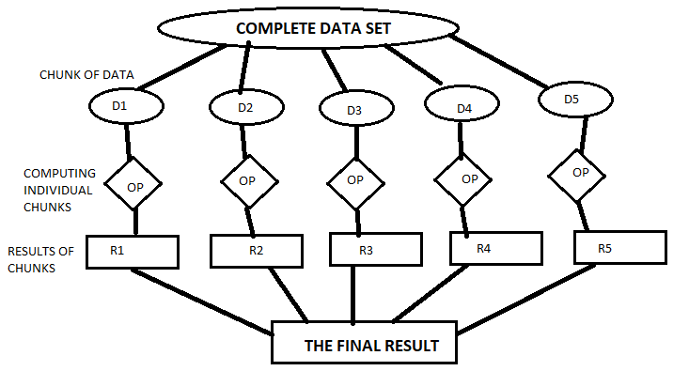
Blocked Algorithm

Slide 7
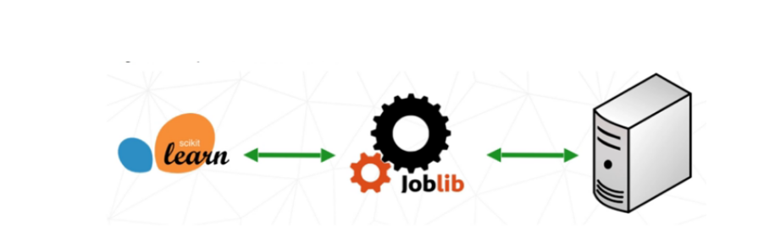
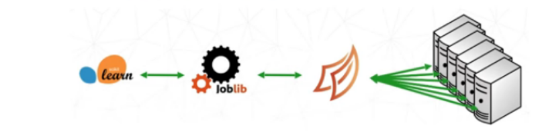
Model Building with Dask
Scikit-learn in parallelisation
Parallelisation using Dask
Notes:
https://www.analyticsvidhya.com/blog/2018/08/dask-big-datasets-machine_learning-python/

Slide 8
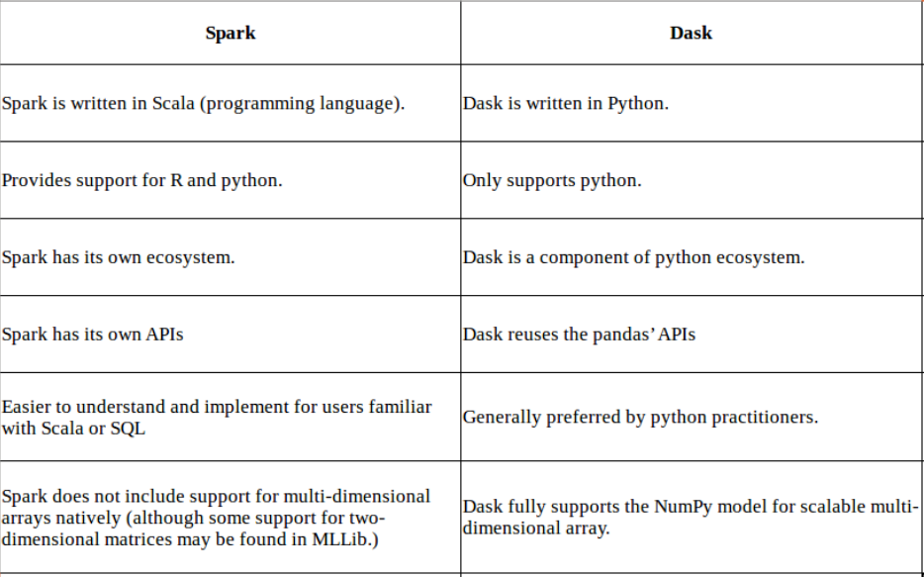
Notes:
https://docs.dask.org/en/latest/spark.html

Slide 9
Limitations of Dask
If your dataset fits comfortably into RAM on your laptop, then you may be better off just using Pandas.
If your dataset doesn’t fit neatly into the Pandas tabular model, then you might find more use in dask.bag or dask.array
If you need functions that are not implemented in Dask DataFrame, then you might want to look at dask.delayed which offers more flexibility
Slowness when compared to Pandas
Set index: df.set_index(df.x)
groupby-apply not on index (with anything): df.groupby(df.x).apply(myfunc)
Join not on the index: dd.merge(df1, df2, on='name')

